Slide 1

WORLD MART
DATA WAREHOUSE IST 722 Prof. P D Taber
Online retail store management System
Shubham Shete Harsh Darji
Harper He

Slide 2
Contents
Overview
Project Planning
Business Requirement Gathering
Design
Deployment
Maintenance and Evaluation

Slide 3
Overview

Slide 4
World Mart - Company Overview
World Mart is a Nationwide located retail corporation that operates on a chain of hypermarkets and grocery Stores.EveryDay Low Price (EDLP) is the cornerstone of our strategy, and our price focus has never been stronger.
Today's customer seeks the convenience of one-stop shopping that we offer. From grocery to all our customer needs and we provide the deep assortment that our customers appreciate.
Mission :
To be the lowest priced retailer in the filed of grocery. It is our continuous endeavor to investigate, identify and make available new product categories for customer’s everyday use and at the best market value.
Vision : “ To know what the customer wants and deliver it at the best price”

Slide 5
Business Case and Project Overview
As data grew from megabytes to gigabytes to petabytes, smart business felt a to store this data efficiently and to utilize it for improving various aspect of business.
Data Warehouse plays an important role, It helps to analyze key aspects to improve sale of retail stores. To know what customer buys and in which season, we need to have a look over the whole data.
Ad-Hoc reporting and dashboard creation for the generation of attribute, location, product specific data can be done using warehousing techniques.
WORLD MART DATA WAREHOUSE
The project is focused towards creating a centralized data warehouse repository that consists of aggregated data coming from different stores.
The data warehouse databases provide a decision support system in which user can calculate and evaluate the performance of the organization over time.
The data will be stored in a series of snapshots, in which each record represents data at a specific time. By analyzing the snapshots, one can compare among the time periods. These comparisons can help user make important business decisions.

Slide 6
Project Planning

Slide 7
Project Inscope and Out of Scope
In scope :
Building a warehouse that provides an estimate of the sales and CRM based on the historical data.
A system that generates KPIs for World Mart based on the historic data that can be used for analytics
Module that includes Data Warehouse, Data mart and Decision Support System Generation
Integration Testing and Beta support testing Mechanism
IT training to the employees and End User training pre-deployment phase
A maintenance plan to provide support to the employees in cases of system crashes and periodic consultation routines to ensure the smooth working of the system.
Out of scope :
Every Business Insight given by the DSS cannot assure an increased sales or customer base, however it can predict a near possibility to what sales might be done in the future.
Erratic change in the behavior of the data due to increased/ decreased sale that are irregular or sporadic data might cause the DSS prediction to go wrong, thus the data inconsistency is not a factor that a warehouse can handle.

Slide 8
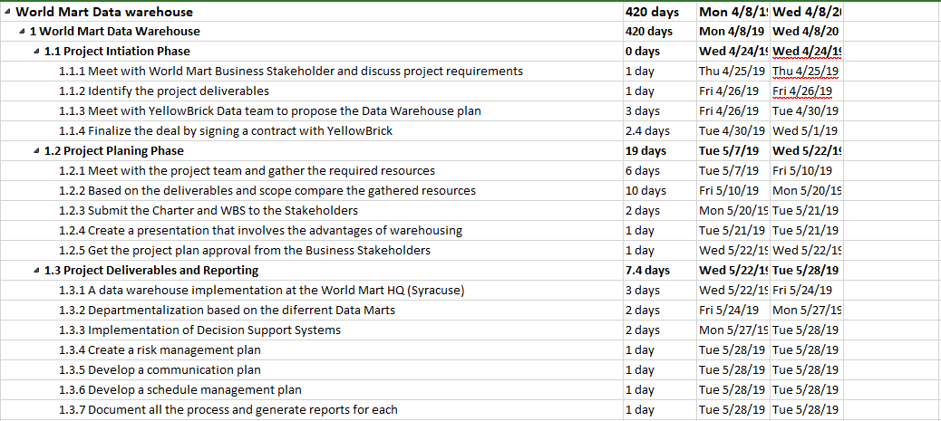
Work Breakdown Structure

Slide 9
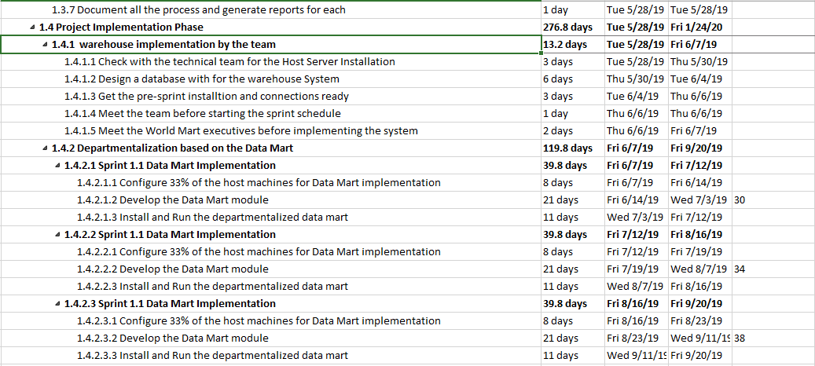

Slide 10
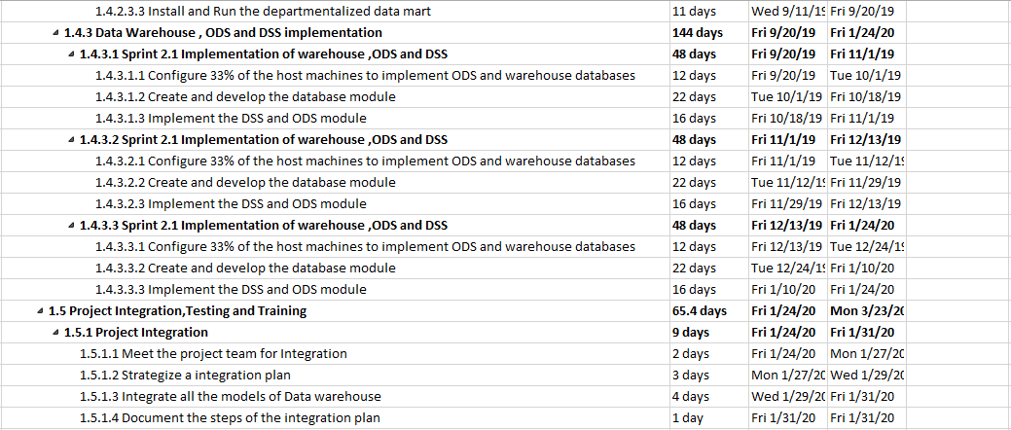

Slide 11
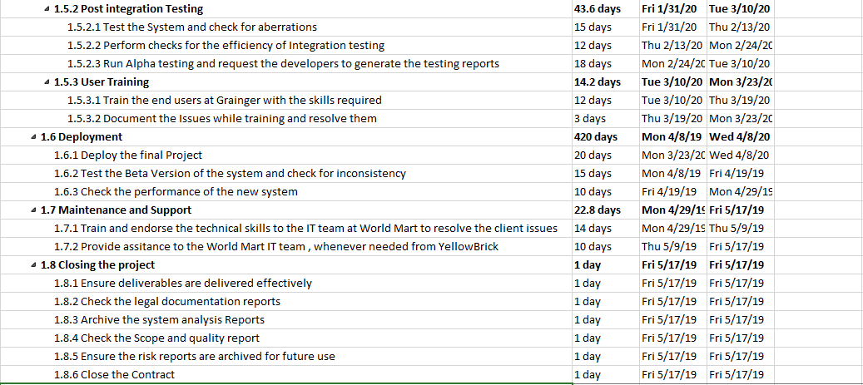

Slide 12
Estimated Cost and ROI
The cost breakdown for the project is mentioned below:
Major Costs:
Storage: 2000$ per month * 12 months = 24000$ annually
All Software: 1000$ per month * 12 months = 12000$ annually
Human Resources: 36,000$ per month (Team of 6) * 12 months = 432,000$
Additional Costs: 50,000$
Total Costs: 516,000$ approximately
Estimated ROI = Company currently has 10000 customers and has a growth of 5 percent with the implementation i.e. 500 and minimum order is of 1800$ = 500 *1800 =900,000$
ROI = 74.4%

Slide 13
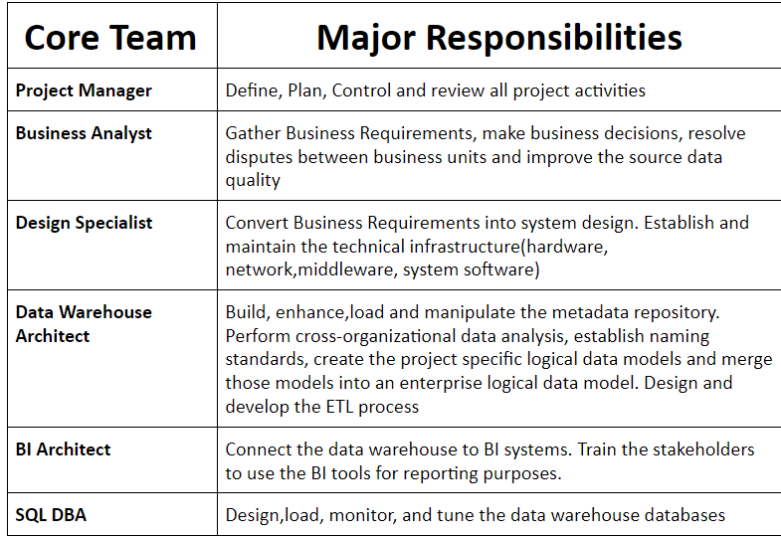
Project Team

Slide 14
Business Requirement Gathering

Slide 15
Project Stakeholders
Project Sponsor: Director of World Mart company who is funding the project
Project Team: Team responsible for implementing the data warehouse
End Users: Employees using the data warehouse for data analytical purposes
Review Board: The team responsible to check whether the DW meets the requirements

Slide 16
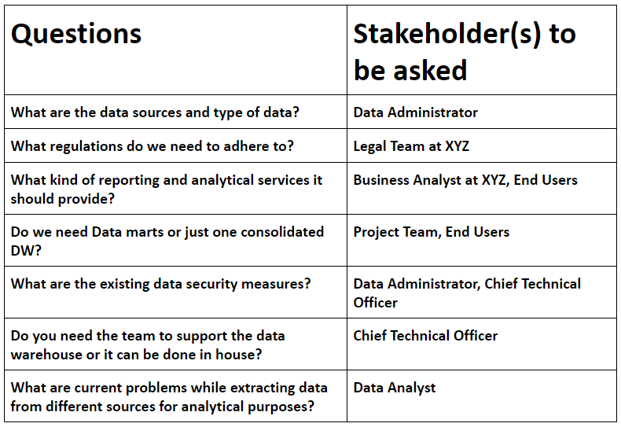
Interview Questions

Slide 17
Design

Slide 18
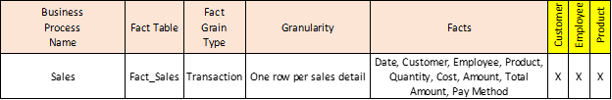
Bus Matrix

Slide 19
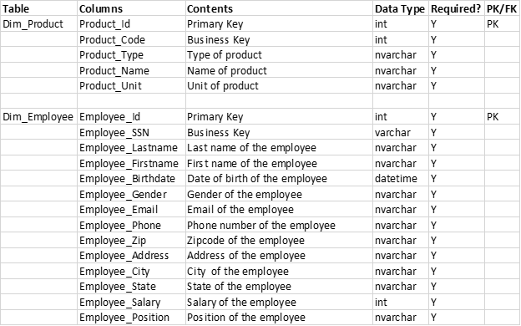
Data Dictionary

Slide 20
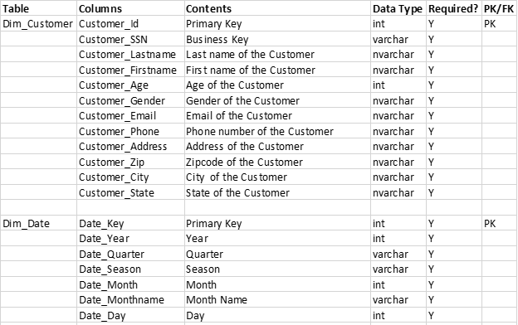
Data Dictionary

Slide 21
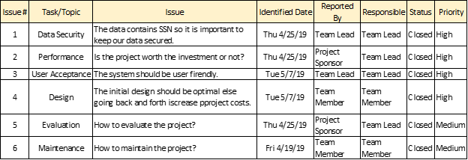
Issues List

Slide 22
Deployment

Slide 23
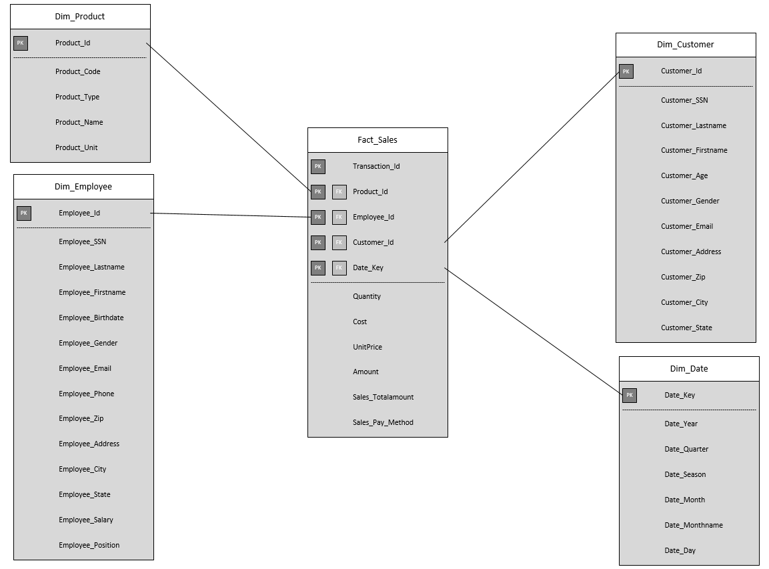
Schemas

Slide 24
SQL Scripts
Fact_Sales
CREATE TABLE[dbo].[Fact_Sales](
Transaction_Id [INT] NOT NULL,
Product_Id [INT] NOT NULL ,
Employee_Id [INT] NOT NULL ,
Customer_Id [INT] NOT NULL ,
Date_Key [INT] NOT NULL ,
Quantity [INT] NOT NULL ,
Cost decimal(10,2) NOT NULL ,
UnitPrice decimal(10,2) NOT NULL ,
Amount decimal(10,2) NOT NULL ,
Sales_Totalamount decimal(10,2) NOT NULL ,
Sales_Pay_Method VARCHAR(100) NOT NULL,
CONSTRAINT Fact_Sales_C FOREIGN KEY (Customer_Id) REFERENCES Dim_Customer(Customer_Id),
CONSTRAINT Fact_Sales_P FOREIGN KEY (Product_Id) REFERENCES Dim_Product(Product_Id),
CONSTRAINT Fact_Sales_D FOREIGN KEY (Date_Key) REFERENCES Dim_Date (Date_Key),
CONSTRAINT Fact_Sales_E FOREIGN KEY (Employee_Id) REFERENCES Dim_Employee(Employee_Id),
PRIMARY KEY (Transaction_Id, Customer_Id,Product_Id,Date_Key,Employee_Id)
)
Dim_Product
CREATE TABLE [dbo].[Dim_Product](
Product_Id [INT] NOT NULL PRIMARY KEY,
Product_Code [INT] NOT NULL,
Product_Type [NVARCHAR] (50) NOT NULL,
Product_Name [NVARCHAR] (50) NOT NULL,
Product_Unit [NVARCHAR] (50) NOT NULL,
)

Slide 25
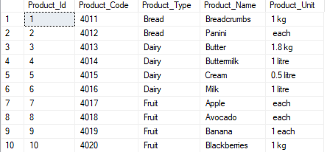
SQL Scripts

Slide 26
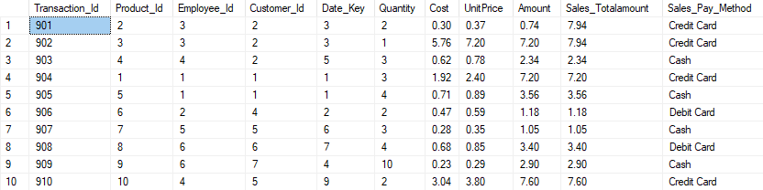
SQL Scripts

Slide 27
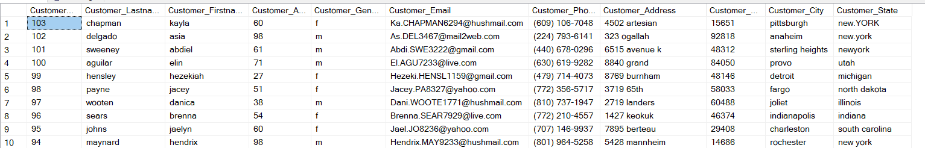
SSIS Transformations
FUZZY GROUPING
Before Transformation
After Transformation

Slide 28
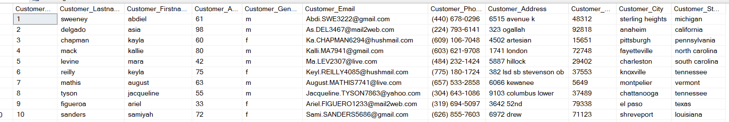
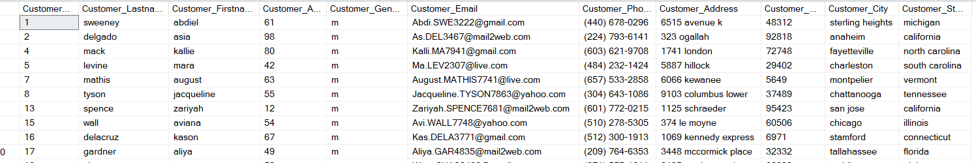
SSIS Transformations
Conditional Split
Before Transformation
After Transformation

Slide 29
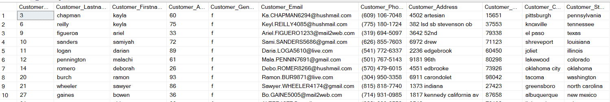
SSIS Transformations
Conditional Split
Before Transformation
After Transformation

Slide 30
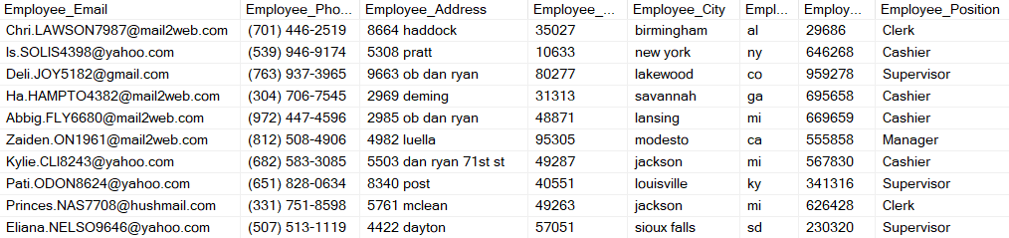
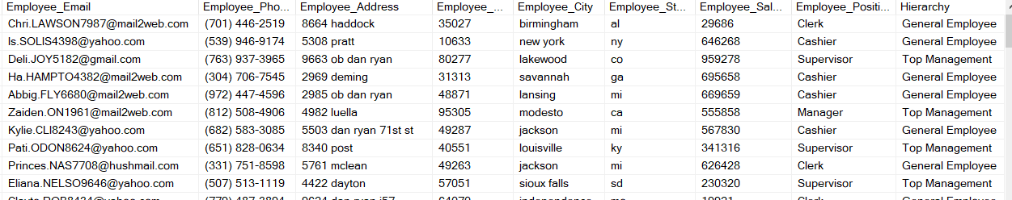
SSIS Transformations
Derived Columns
Before Transformation
After Transformation

Slide 31
Maintenance and Evaluation

Slide 32
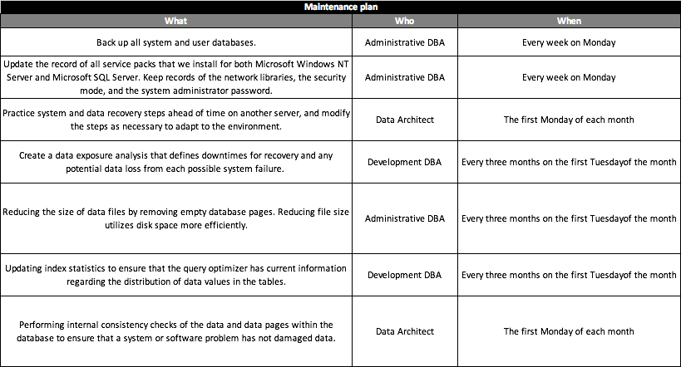
Maintenance Plan

Slide 33
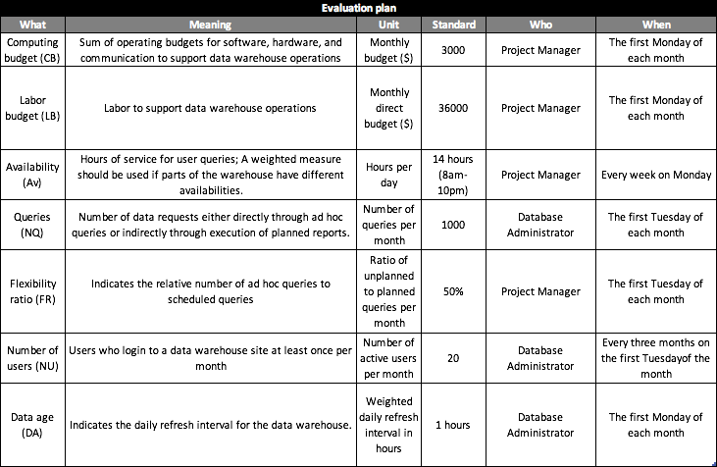
Evaluation Plan

